Slide 1

CMR TECHNICAL CAMPUS UGC AUTONOMOUS ACCREDITED BY NBA & NAAC WITH 'A' GRADE, APPROVED BY AICTE, NEW DELHI, AND JNTU HYDERABAD KANDLAKOYA (V),MEDCHAL RD, HYDERABAD,TELANGANA 501 401 REAL TIME OBJECT DETECTION USING CNN BASED IMAGE CLASSIFICATION BATCH-22
BY
G. Sai Kumar(217R1A0521)
G .Sushmitha(217R1A0526)
Subhashish Saha(217R1A0553)
Under the Guidance of:-
Dr. J. Narasimharao
(Associate Professor)

Slide 2
CSE Department Vision and Mission
Vision:
To Provide quality education and a conducive
learning environment in computer engineering
that foster critical thinking, creativity, and
practical problem-solving skills.

Slide 3
Mission:
1. To educate the students in fundamental principles of computing and induce the skills needed to solve practical problems.
2. To provide State-of-the-art computing laboratory facilities to promote industry institute interaction to enhance student’s practical knowledge.
3. To Inculcate self-learning abilities, team spirit, and professional ethics among the students to serve society.

Slide 4
TABLE OF CONTENTS
Abstract
Existing System
Disadvantages of Existing Systems
Proposed System
Advantages
Hardware and Software Requirements
Novelty
Architecture
Modules
UML Diagrams
- Use case Diagram
- Class Diagram
- Sequence Diagram
Sample Code
Results
Conclusion
Future Scope
References

Slide 5
ABSTRACT
Image classification model using Convolutional Neural Networks with Tensor flow.
A multi-category image data set has been considered for the classification.
The classifier train this proposed classifier to calculate the decision boundary of the image dataset.
Convolutional Neural Networks(CNNs) are a leading approach in computer vision for image classification due to their high accuracy and efficiency.
Image classification is process including image preprocessing, image segmentation, key feature extraction and matching identification.
With the latest figures image classification techniques, we get the picture information faster.

Slide 6
Existing Systems
Image classification relied on algorithms like k-Nearest Neighbors (k-NN), Support Vector Machines (SVMs), Decision Trees, and Naive Bayes classifiers.
Features such as edges, textures, and shapes were manually extracted using techniques like:
Scale-Invariant Feature Transform (SIFT)
Histogram of Oriented Gradients (HOG)
Local Binary Patterns (LBP)
Extracted features were fed into classifiers such as SVMs or k-NN for categorization.
These methods worked well for smaller datasets but struggled with large-scale, high-dimensional data.
Manual feature extraction limited the ability to capture complex patterns, reducing classification accuracy for more intricate image datasets.

Slide 7
Disadvantages of Existing Systems
Manual Feature Extraction
Limited Pattern Recognition
High Computational Cost
Risk of Overfitting
Lack of Adaptability
Lower Accuracy

Slide 8
Proposed System
Convolutional Neural Networks(CNNs):
A Convolutional Neural Network (CNN) is a deep learning architecture specifically designed for image classification. It automatically learns features from raw images, eliminating the need for manual feature extraction. CNNs are widely used for tasks like object detection, facial recognition, and medical image analysis .Classifies and save the images in separate folder according to the class.
Capture Complex Patterns :Convolutional layers extract spatial features such as edges, textures and intricate shapes at multiple levels .Pooling layers reduce dimensionality while retaining essential information.
Deep Network Representation :Enables robust and adaptable learning, making it suitable for large-scale datasets. Implements techniques like dropout and batch normalization to improve model generalization.
Classifies the images with more accuracy and useful in fields like healthcare , automous driving, and agriculture, where high precision is essential.

Slide 9
Advantages of Proposed System
Automated Feature Extraction:
CNNs learn features directly from raw images, eliminating the need for manual feature engineering.
High Accuracy:
CNNs outperform traditional machine learning models by Capturing detailed spatial relationships in images.
Generalization and Reduced Overfitting:
Techniques like dropout and batch normalization improve generalization to new datasets.
Efficient Processing of High-Dimensional Data:
It allows effective learning from large-scale datasets and Adaptability.

Slide 10
Hardware and Software Requirements
HARDWARE REQUIREMENTS:
Processor : Pentium 4
Ram : 4GB Ram.
Hard disk : 20GB
SOFTWARE REQUIREMENTS:
Operating system : Windows 11
Coding Language : python 3.7.0
Software library : numPy, tensor flow, Keras

Slide 11
Novelty of Project
1.Efficient Processing of Large Datasets:
CNNs handle high-dimensional data efficiency by using pooling layers, which optimize computational cost while retaining important image features
2.Hierarchical Feature Representation:
The use of convolutional layers allows the model to capture spatial hierarchies, from simple edges to complex patterns, improving recognition accuracy.
3.Reduced Overfitting with Advanced Techniques:
Incorporating dropout and batch normalization enhances model generalization, reducing the risk of overfitting on training data.
4.Versatility Across Applications:
The proposed system is adaptable for various real world applications, such as medical imaging, autonomous driving, and precision agriculture, demonstrating its broad impact and effectiveness.

Slide 12
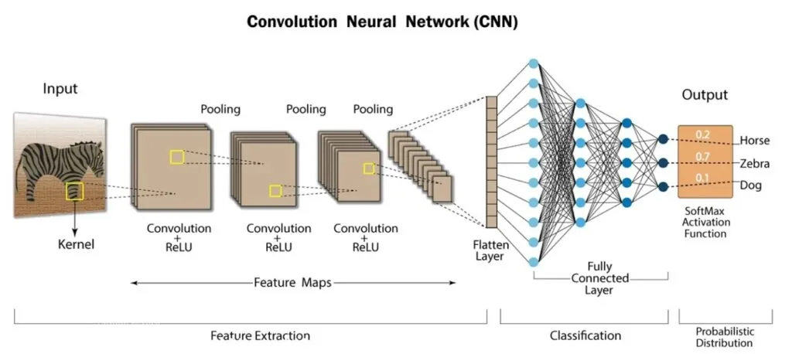
Architecture

Slide 13
STEPS IN THE ARCHITECTURE
Input image
Layers
Convolutional Layer
RELU Operation
Pooling Layers
Flattening
Fully connected Layers
SoftMax Activation Function

Slide 14
Modules
1.GUI-Real Modules(Tkinter)
Tkinter enhances usability by providing a graphical interface, making image classification accessible even to non-programmers. It integrates seamlessly with Keras, OpenCV, and NumPy to create a smooth workflow.
2.Tensor flow
TensorFlow is a free and open-source software library for dataflow and differentiable programming across a range of tasks. It is a symbolic math library, and is also used for machine learning applications such as neural networks.
3.Keras Module
It build and train CNN models effectively. It improve image feature extraction and classification. Allow model saving and loading for future predictions.

Slide 15
4.Data Handling & Scientific Computing
NumPy
NumPy is a general-purpose array-processing package. It provides a high-performance multidimensional array object, and tools for working with these arrays.
Pandas
Pandas is an open-source Python Library providing high-performance data manipulation and analysis tool using its powerful data structures. Python was majorly used for data munging and preparation.
5.Image Processing & Computer Vision
Cv2(OpenCV)-Reads, processes and displays images.
imutils- Provides additional image manipulation functions.
os-Checks file existence and interacts with the filesystem.

Slide 16
UML Diagrams
UML(Unified Modeling Language) diagrams are visual representations of a system’s structure, interactions, functionality and behaviour.
It is used in software engineering to model, design and document software system.
UML diagrams including Use case diagram, Class diagram, sequence diagram, statechart diagram.

Slide 17
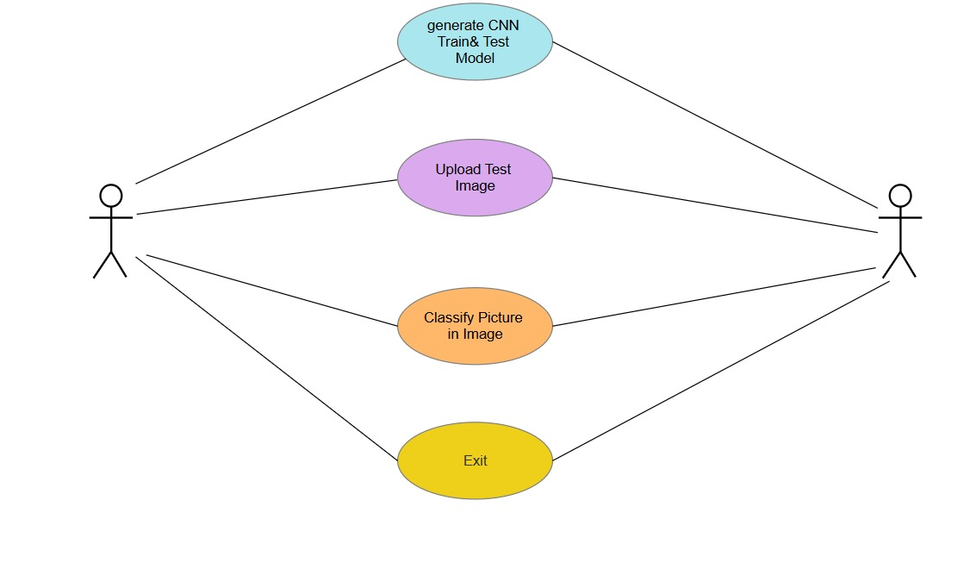
Use Case diagram

Slide 18
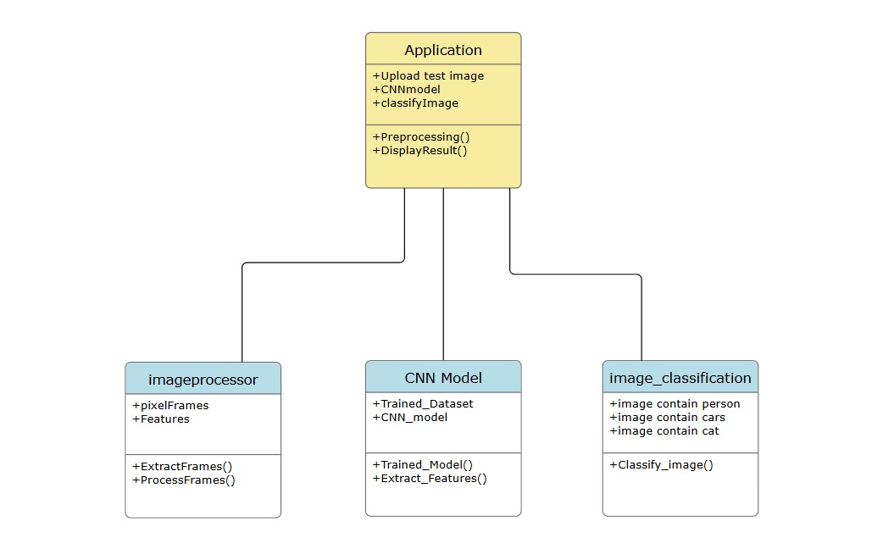
Class diagram

Slide 19
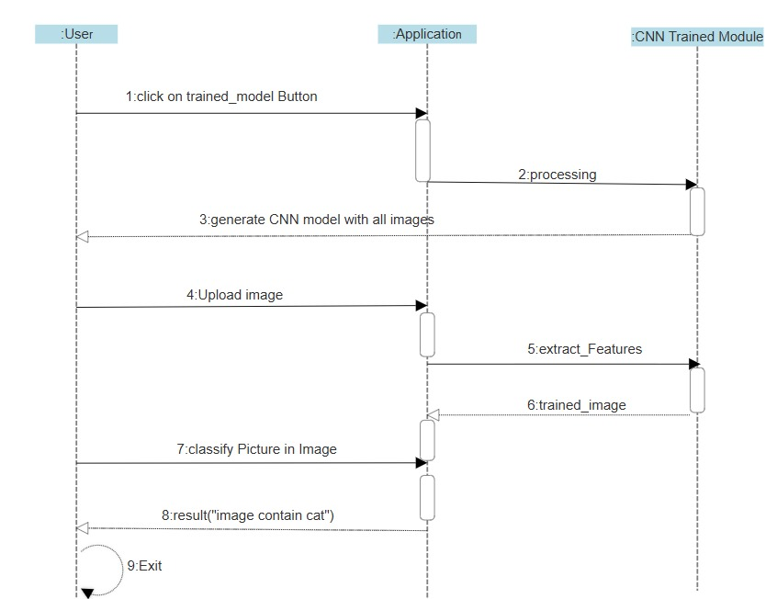
Sequence diagram

Slide 20
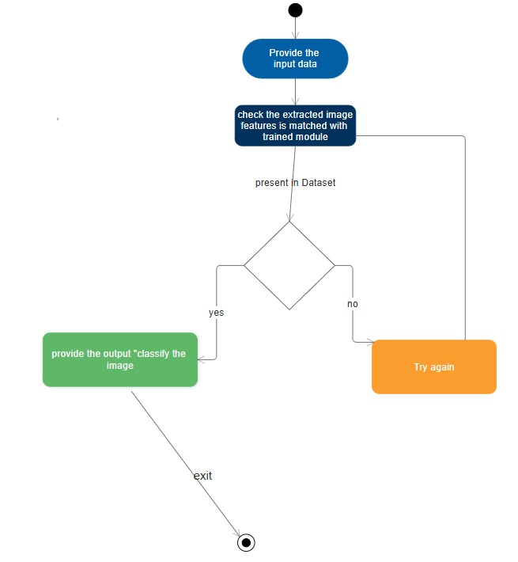
Statechart diagram

Slide 21
DATASET
CIFAR-10
CIFAR-10 is a well-known dataset in computer vision, widely used for training and evaluating image classification models.
Size and Format: The dataset consists of 60,000 color images of various objects like: Cars, Dogs, Airplane, person.
Dimensions: 32×32 pixels.
Training and Testing Split:
50,000 training images (distributed across 5 batches of 10,000 images each).
10,000 test images (1,000 images per class).
Distribution:
The test set is balanced, with exactly 1,000 images per class.
The training set is slightly unbalanced within batches but maintains 5,000 images per class overall.
CIFAR-10 is widely used in deep learning research, particularly for benchmarking convolutional neural networks (CNNs).

Slide 22
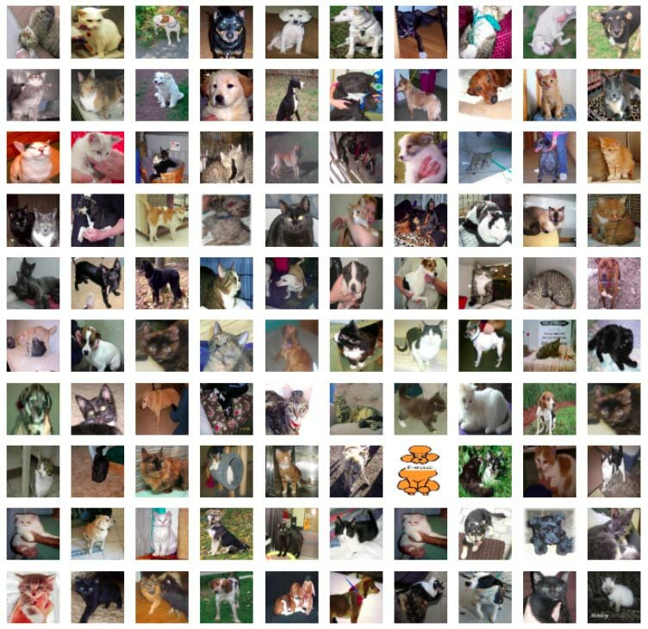
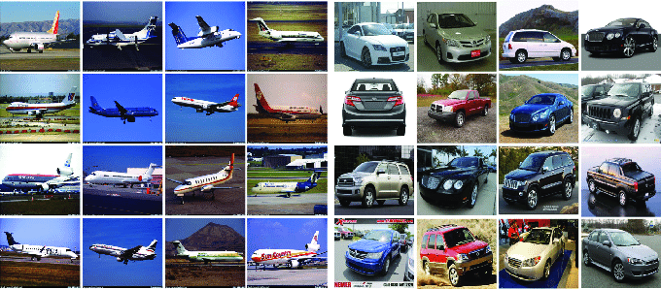
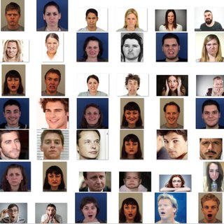

Slide 23
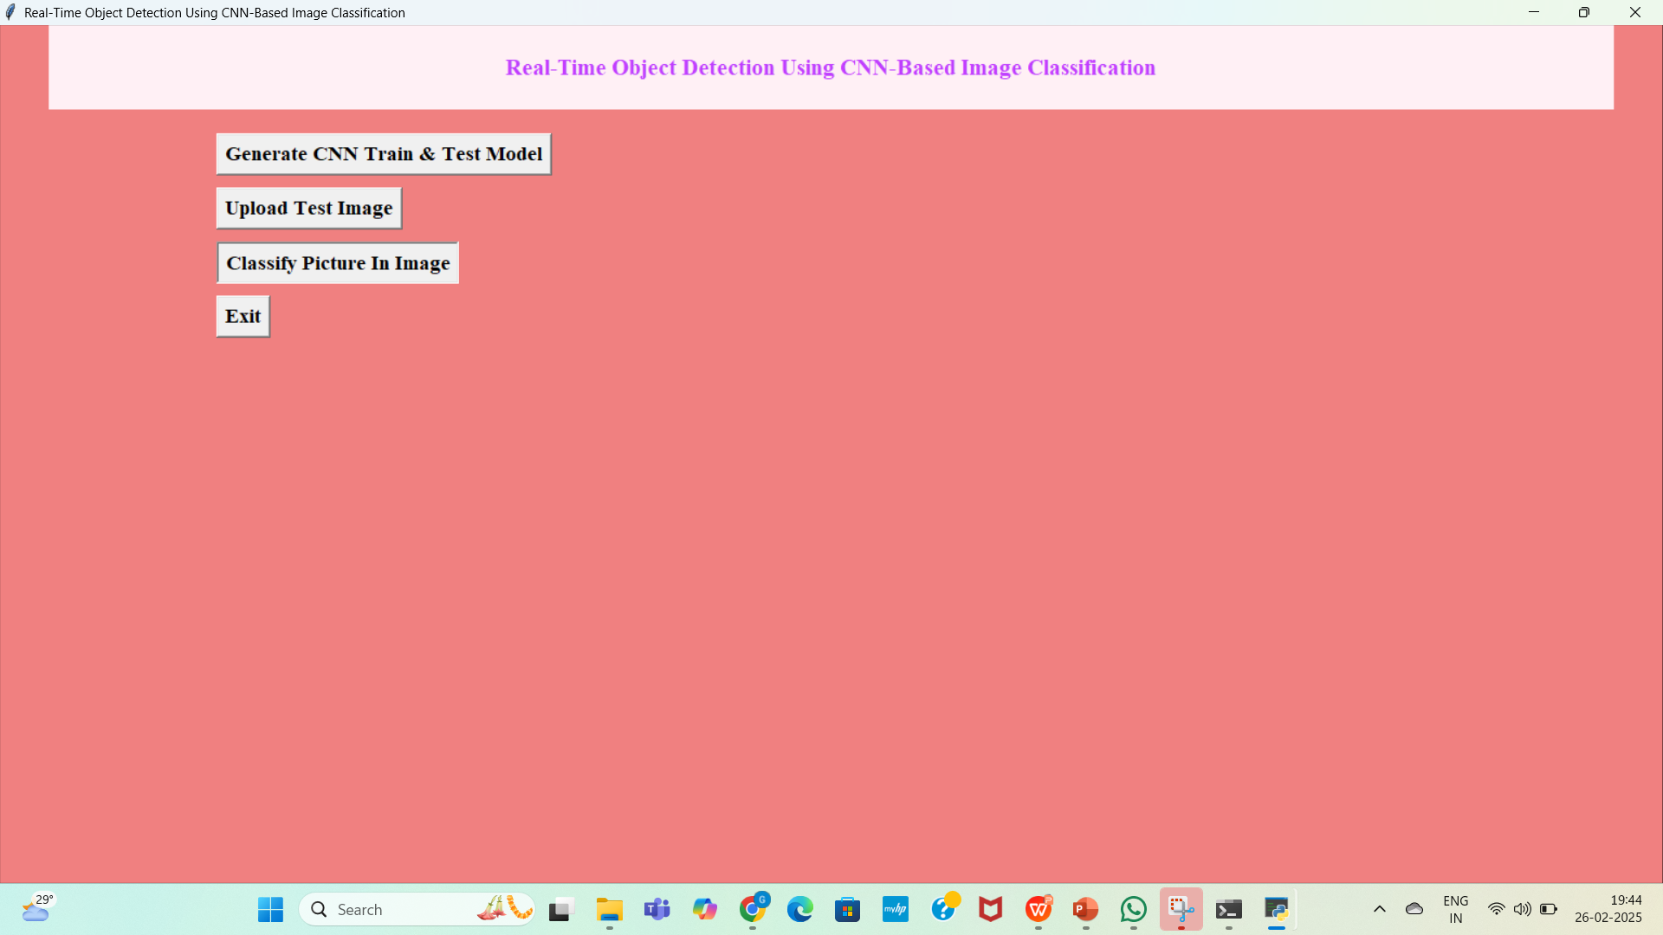
Working Model

Slide 24
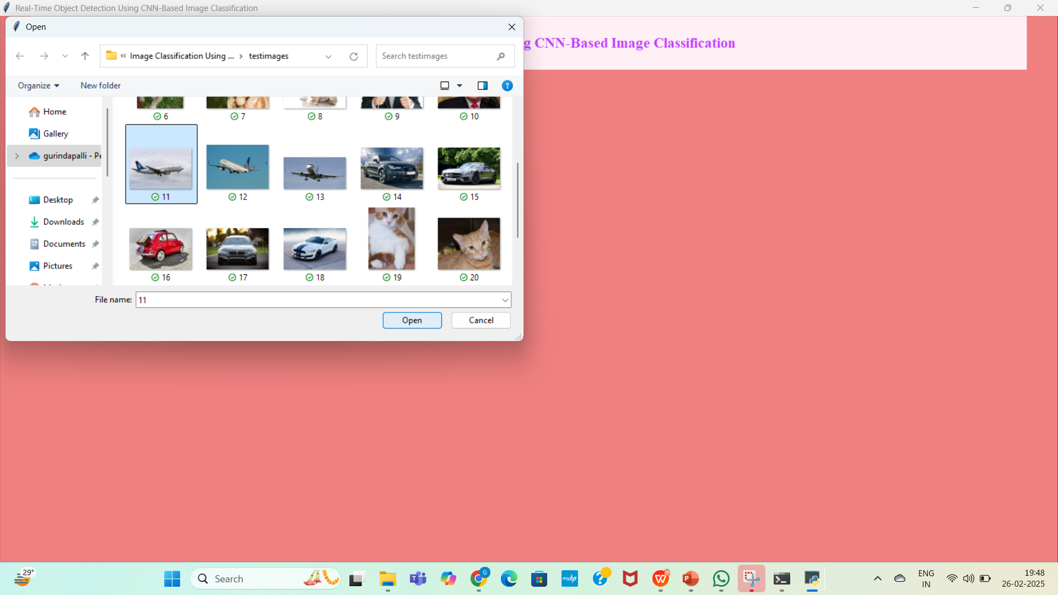

Slide 25
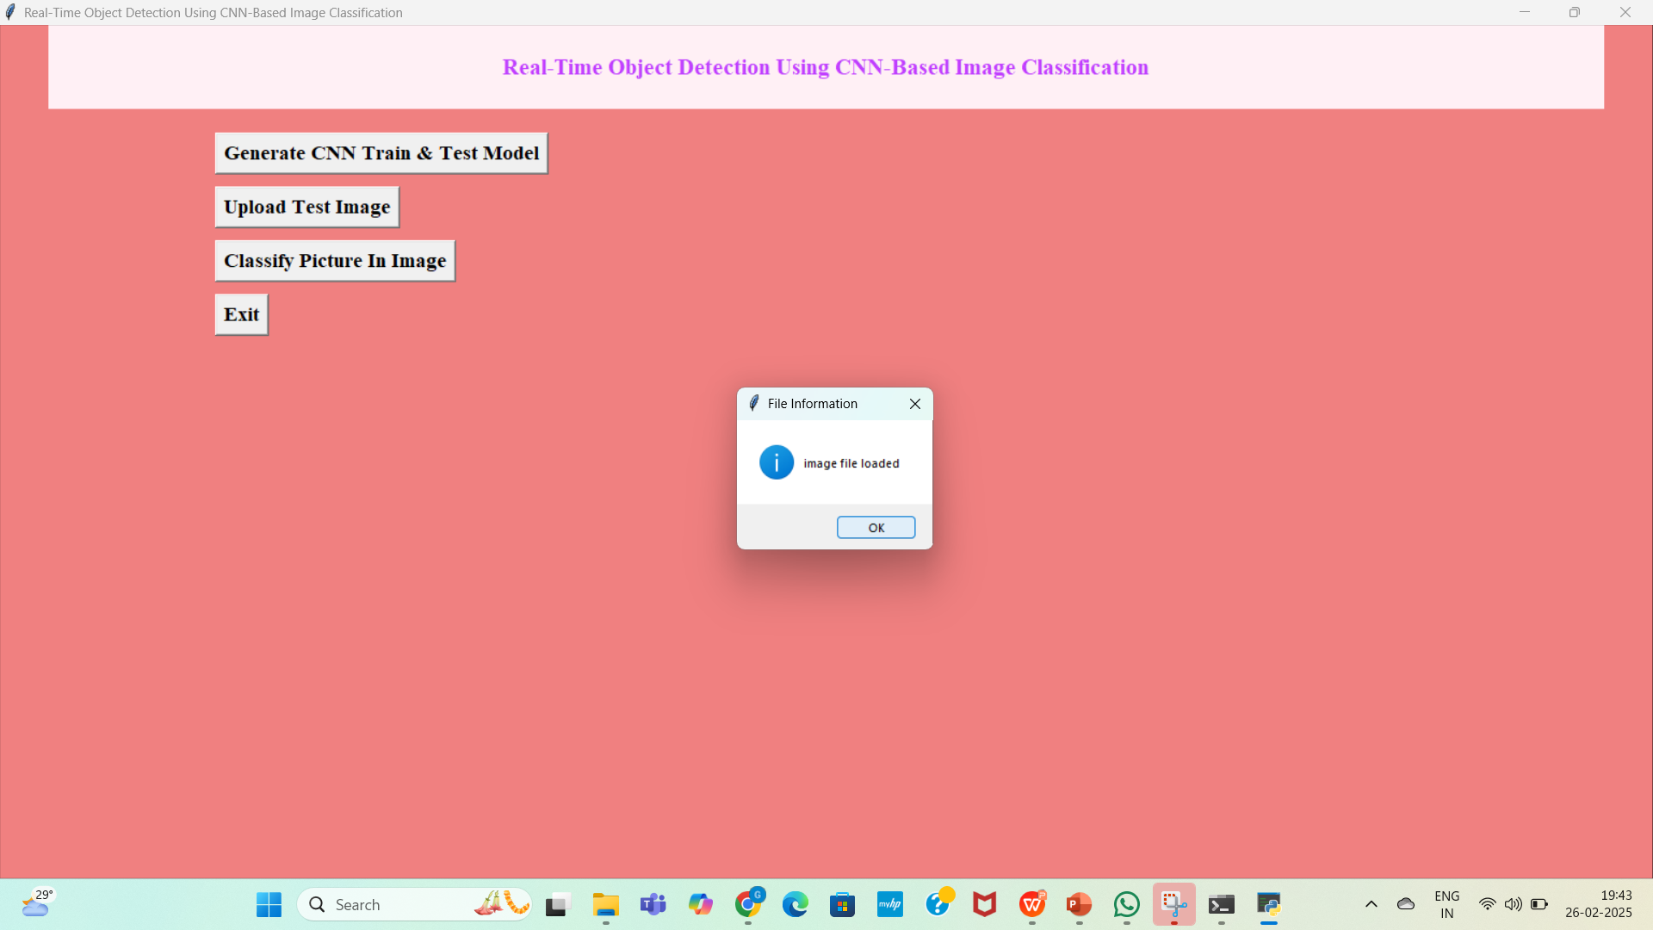

Slide 26
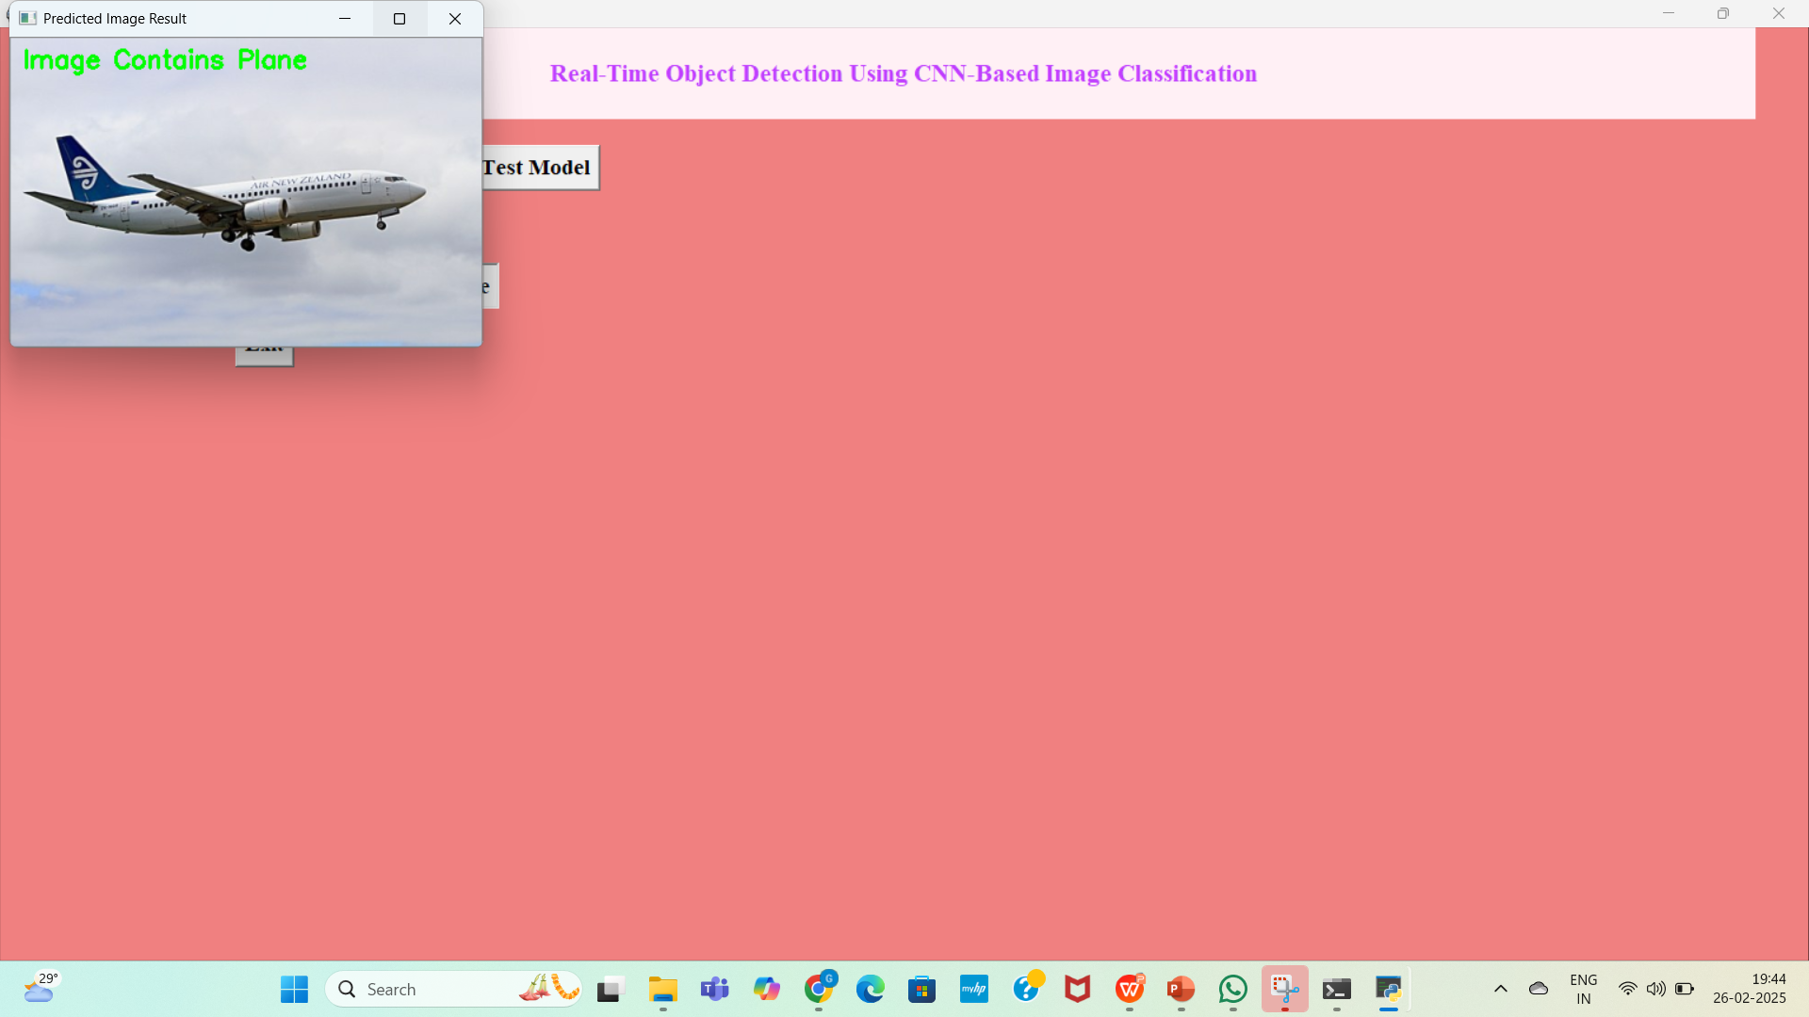

Slide 27
SAMPLE CODE
#{'cars': 0, 'cats': 1, 'dogs': 2, 'person': 3, 'planes': 4}
from tkinter import *
import tkinter
from tkinter import filedialog
import numpy as np
from tkinter.filedialog import askopenfilename
import pandas as pd
from keras.optimizers import Adam
from keras.models import model_from_json
from tkinter import simpledialog
from keras.models import Sequential
from keras.layers import Convolution2D
from keras.layers import MaxPooling2D
from keras.layers import Flatten
from keras.layers import Dense
import os
from keras.preprocessing import image
from keras.preprocessing.image import ImageDataGenerator
from tkinter import messagebox
import cv2
from imutils import paths
import imutils

Slide 28
main = tkinter.Tk()
main.title("From Pixels to Predictions: Image with CNNs") #designing main screen
main.geometry("600x500")
global filename
global loaded_model
def upload(): #function to upload tweeter profile
global filename
filename = filedialog.askopenfilename(initialdir="testimages")
messagebox.showinfo("File Information", "image file loaded")
def generateModel():
global loaded_model
if os.path.exists('model.json'):
with open('model.json', "r") as json_file:
loaded_model_json = json_file.read()
loaded_model = model_from_json(loaded_model_json)
loaded_model.load_weights("model_weights.h5")
loaded_model._make_predict_function()
print(loaded_model.summary)
messagebox.showinfo("Model Generated", "CNN Model Generated on Train & Test Data. See black console for details")
else:
classifier = Sequential()

Slide 29
classifier.add(Convolution2D(32, 3, 3, input_shape = (48, 48, 3), activation = 'relu'))
classifier.add(MaxPooling2D(pool_size = (2, 2)))
classifier.add(Convolution2D(32, 3, 3, input_shape = (48, 48, 3), activation = 'relu'))
classifier.add(MaxPooling2D(pool_size = (2, 2)))
classifier.add(Convolution2D(32, 3, 3, activation = 'relu'))
classifier.add(MaxPooling2D(pool_size = (2, 2)))
classifier.add(Flatten())
classifier.add(Dense(output_dim = 128, activation = 'relu'))
classifier.add(Dense(output_dim = 5, activation = 'softmax'))
classifier.compile(optimizer = 'adam', loss = 'categorical_crossentropy', metrics = ['accuracy'])
train_datagen = ImageDataGenerator()
test_datagen = ImageDataGenerator()
training_set = train_datagen.flow_from_directory('data/train',
target_size = (48, 48),
batch_size = 32,
class_mode = 'categorical',
shuffle=True)
test_set = test_datagen.flow_from_directory('data/validation',
target_size = (48, 48),
batch_size = 32,
class_mode = 'categorical',
shuffle=False)
classifier.fit_generator(training_set,
samples_per_epoch = 8000,
nb_epoch = 1,
validation_data = test_set,
nb_val_samples = 2000)

Slide 30
classifier.save_weights('model_weights.h5')
model_json = classifier.to_json()
with open("model.json", "w") as json_file:
json_file.write(model_json)
print(training_set.class_indices)
print(classifier.summary)
messagebox.showinfo("Model Generated", "CNN Model Generated on Train & Test Data. See black console for details")
def classify():
imagetest = image.load_img(filename, target_size = (48,48))
imagetest = image.img_to_array(imagetest)
imagetest = np.expand_dims(imagetest, axis = 0)
preds = loaded_model.predict(imagetest)
print(str(preds)+" "+str(np.argmax(preds)))
predict = np.argmax(preds)
msg = ""
if predict == 0:
msg = "Image Contains Car"
if predict == 1:
msg = "Image Contains Cat"
if predict == 2:
msg = "Image Contains Dog"
if predict == 3:
msg = "Image Contains Person"
if predict == 4:

Slide 31
msg = "Image Contains Plane"
imagedisplay = cv2.imread(filename
orig = imagedisplay.copy()
output = imutils.resize(orig, width=400)
cv2.putText(output, msg, (10, 25), cv2.FONT_HERSHEY_SIMPLEX,0.7, (0, 255, 0),
cv2.imshow("Predicted Image Result", output)
cv2.waitKey(0)
def exit():
global main
main.destroy()
font = ('times', 16, 'bold')
title = Label(main, text='From Pixels to Predictions: Image Classification with CNNs', justify=LEFT)
title.config(bg='lavender blush', fg='DarkOrchid1')
title.config(font=font)
title.config(height=3, width=120)
title.place(x=100,y=5)
title.pack()
font1 = ('times', 14, 'bold')
model = Button(main, text="Generate CNN Train & Test Model", command=generateModel)
model.place(x=200,y=100)
model.config(font=font1)

Slide 32
uploadimage = Button(main, text="Upload Test Image", command=upload)
uploadimage.place(x=200,y=150)
uploadimage.config(font=font1)
classifyimage = Button(main, text="Classify Picture In Image", command=classify)
classifyimage.place(x=200,y=200)
classifyimage.config(font=font1)
exitapp = Button(main, text="Exit", command=exit)
exitapp.place(x=200,y=250)
exitapp.config(font=font1)
main.config(bg='light coral')
main.mainloop()

Slide 33
Result
This project utilizes Python, Keras, and Google TensorFlow for image classification.
The CNN algorithm achieves up to 90% accuracy, outperforming traditional algorithms like SVM and KNN.
CNN requires training with all possible images before classification.
When a new image is uploaded, the trained CNN model is applied to predict or identify the image.
The results demonstrate CNN’s superior performance in image classification tasks.

Slide 34
Conclusion
This work focuses on classifying images using Convolutional Neural Networks (CNN).
CNN offers optimized image classification compared to traditional algorithms.
Advancements in neural networks will further simplify image classification problems.
Image classification has diverse applications, increasing the importance of neural networks.

Slide 35
Future Scope
Extension of this work for real-time image processing.
Application in validation and verification of real-time images.
Enhancements to detect and prevent image spoofing.
Implementation in various domains like biometrics, surveillance, and medical imaging.
Further improvements in CNN architectures for higher accuracy and efficiency.

Slide 36
References
[1] Chan T H, Jia K, Gao S, et al. “PCANet: A simple deep learning baseline for image classification,” arXiv preprint arXiv:1404.3606, 2014.
[2] TKrizhevsky A, Sutskever I, Hinton G E, “Imagenet classification with deep convolutional neural networks,” Advances in neural information processing systems, pp. 1097-1105, 2012. [3] Bouvrie J, “Notes on convolutional neural networks,” Neural Nets, 2006.
[4] Chan T H, Jia K, Gao S, et al. “PCANet: A simple deep learning baseline for image classification,” arXiv preprint arXiv:1404.3606, 2014.
[5] Joseph Redmon, Santosh Divvala, Ross Girshick, Ali Farhadi, “You Only LookOnce: Unified, Real-Time Object Detection,” arXiv:1506.02640[cs.CV]

Slide 37
Github Link
https://github.com/gadaboinasaikumar521/REAL-TIME-OBJECT-DETECTION-USING-CNN-BASED-IMAGE-CLASSIFICATION

Slide 38
THANK YOU
BY
G. Sai Kumar(217R1A0521) Under the Guidance of:-
G .Sushmitha(217R1A0526) Dr. J. Narasimharao
Subhashish Saha(217R1A0553) (Associate Professor)

